Slide 1
Employee Attrition
Tadd Backus
August 5, 2022

Slide 2
What is the Data?
Employee Attrition Data
870 rows and 37 columns
Variables of interest
ID
Age
Attrition
BusinessTravel
DailyRate
Department
DistanceFromHome
Education
Education Field
EmployeeCount
EmployeeNumber
EnvironmentSatisfaction
Gender
HourlyRate
JobInvolvement
JobLevel
JobRole
JobSatisfaction
MaritalStatus
MonthlyIncome
NumCompaniesWorked
Over18
OverTime
PercentSalaryHike
PerformanceRating
RelationshipSatisfaction
StandardHours
StockOptionLevel
TotalWorkingYears
TrainingTimesLastYear
WorkLifeBalance
YearsAtCompany
YearsInCurrentRole
YearsSinceLastPromotion
YearsWithCurrManager

Slide 3
The problem
Find the factors that contribute the most to employee attrition
Job Role/Department
Monthly Income
Over Time
Identify any trends that exist amongst job roles
Monthly Income
Job Satisfaction

Slide 4
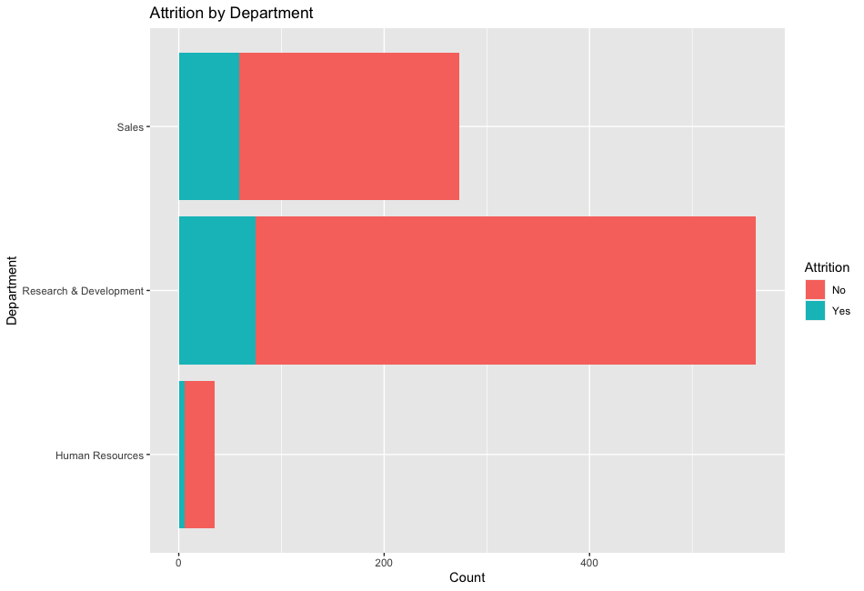
Department impact on attrition
Employees in the Sales Department had a higher percentage of employee attrition than the other departments.
Attrition? | Human Resources | R&D | Sales
Yes | 6 | 75 | 59
No | 29 | 487 | 214
Percent Attrition | 17.14% | 13.35% | 21.61%

Slide 5
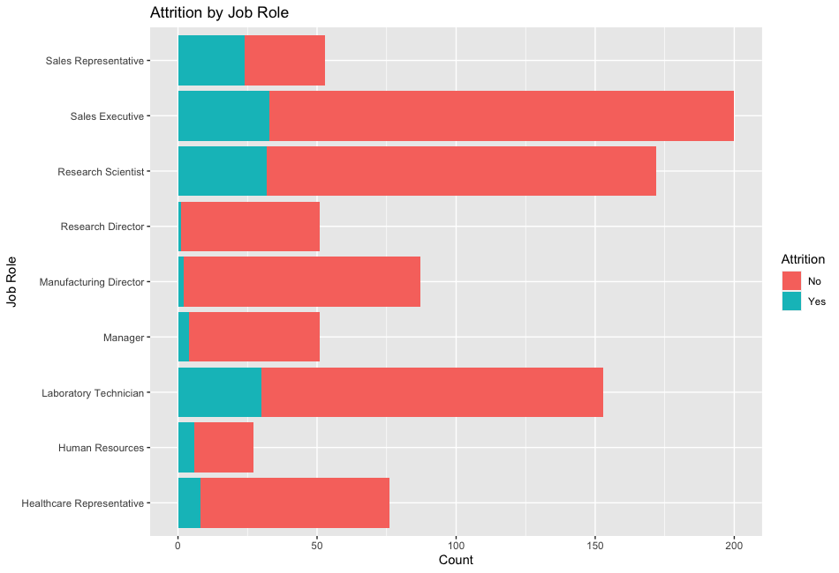
Job Role impact on attrition
Sales Representatives had a significantly higher percentage of attrition than other roles
Manufacturing and Research Directors both had very low rates of attrition.
Attrition? | Healthcare Rep. | Human Resources | Lab Tech | Manager | Manuf. Director | Research Director | Research Scientist | Sales Exec. | Sales Rep.
Yes | 8 | 6 | 30 | 4 | 2 | 1 | 32 | 33 | 24
No | 68 | 21 | 123 | 47 | 85 | 50 | 140 | 167 | 29
Percent Attrition | 10.53% | 22.22% | 19.61% | 7.84% | 2.30% | 1.96% | 18.60% | 16.50% | 45.28%

Slide 6
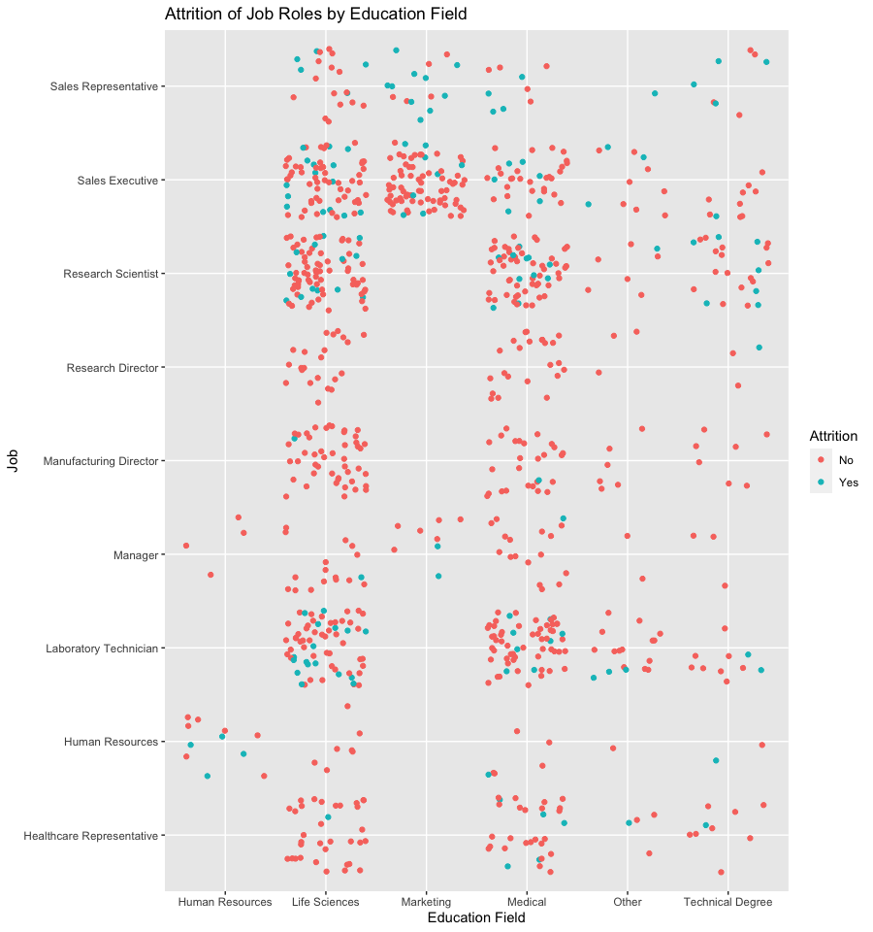
Job Role and Education Field impact on attrition
Sales Representatives had significant rates of attrition regardless of education field
Laboratory Technicians seem to have a higher attrition rate if their education was in Life Sciences rather than other educations

Slide 7
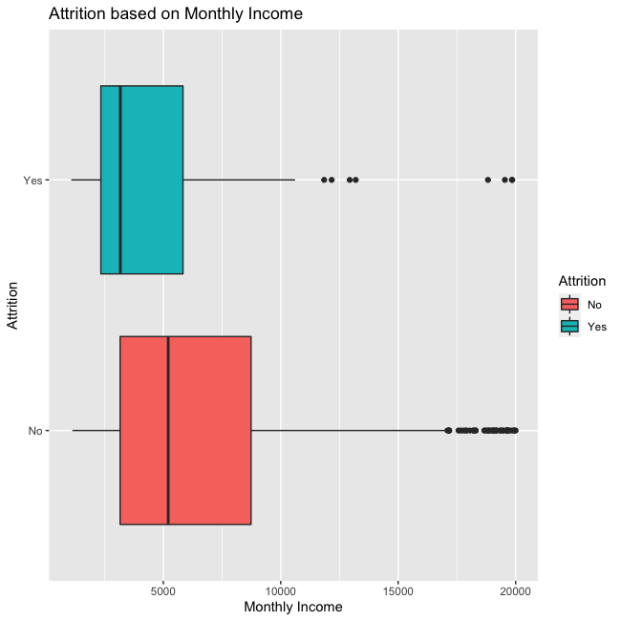
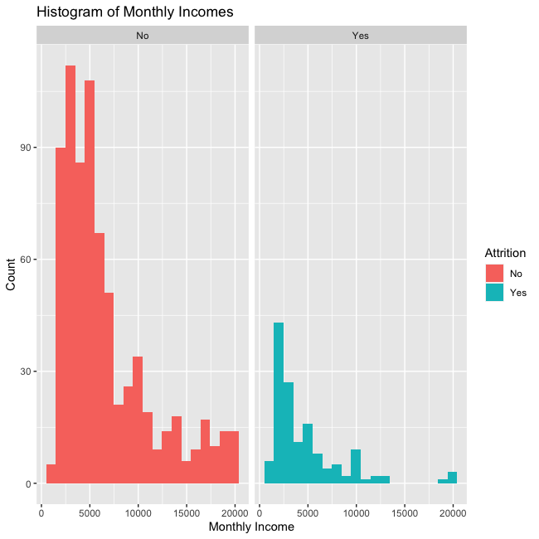
Monthly Income impact on attrition
There seems to be a difference in monthly incomes
However, the data looks heavily right skewed.

Slide 8
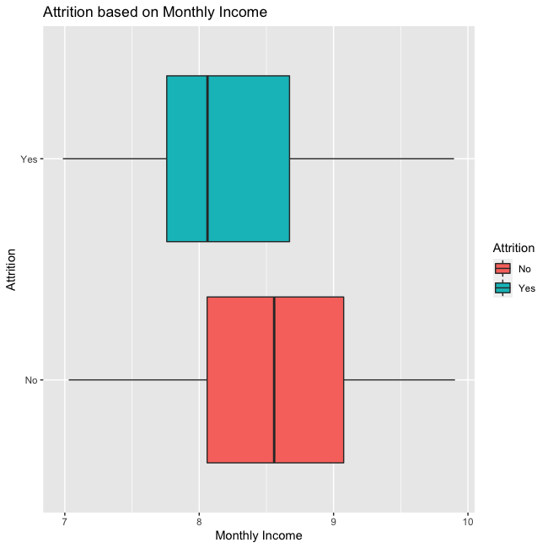
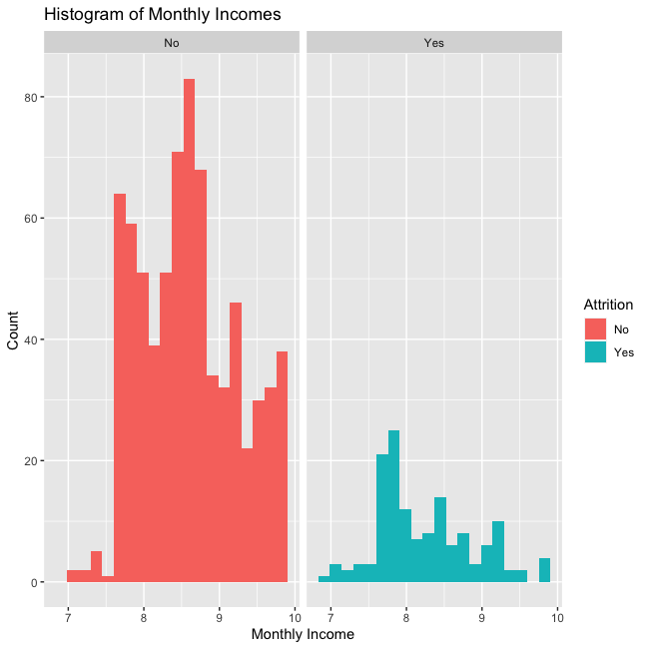
Monthly Income impact on attrition
After log transforming a two-sample t-test was performed on the monthly income data.
There is evidence to suggest that the median income for workers who quit is lower than workers who did not quit (p-value<0.000001).

Slide 9
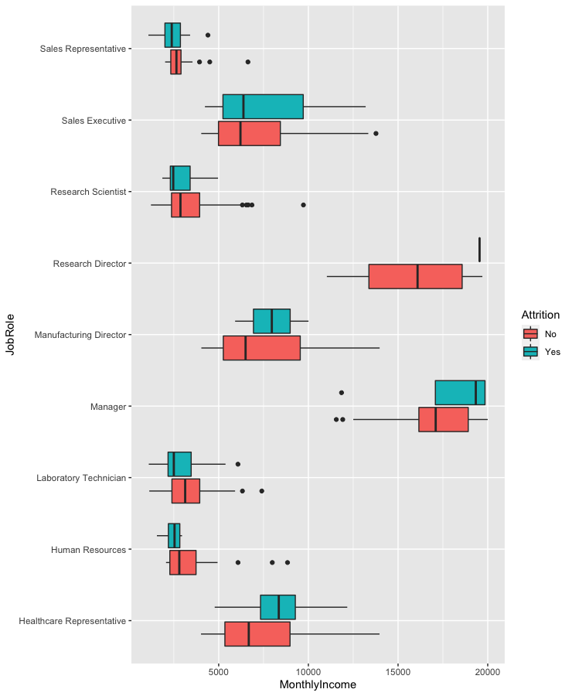
Monthly Income and Job Role’s impact on Attrition
Attrition of Sales Representatives didn’t seem to be impacted by Monthly Income
Managers had a higher attrition rate at higher Monthly Incomes

Slide 10
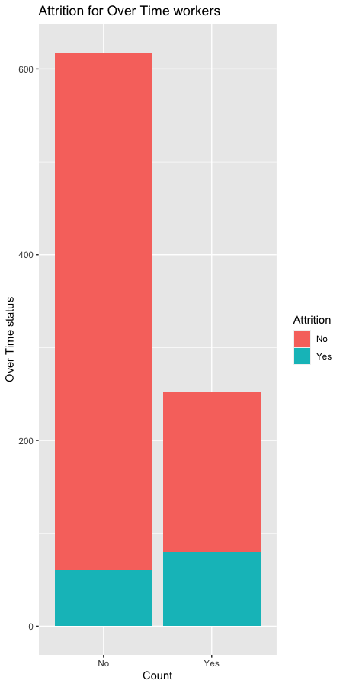
Over Time’s effect on Attrition
Nearly 32% of employees that worked overtime left the company
Less than 10% of employees left if they didn’t work over time
Attrition? | No Over Time | Over Time
Yes | 60 | 80
No | 558 | 172
Percent Attrition | 9.71% | 31.75%

Slide 11
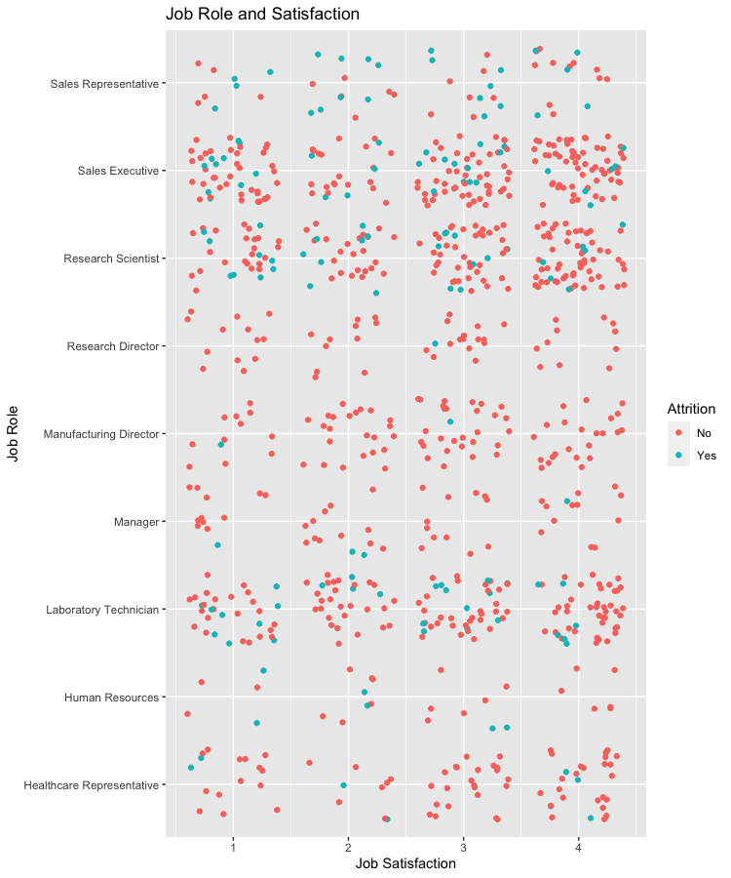
Job Satisfaction’s effect on Attrition for different Job Roles
Job Satisfaction seems to have little impact on Attrition for most Job Roles
Some Job Roles look to have slightly higher Attrition at lower Job Satisfaction
Sales Representative
Sales Executive
Research Scientist

Slide 12
Attrition Prediction Model
kNN Models
Happiness Weight=0.6
Pay Weight=0.2
Experience Weight=0.2
Happiness Model
Age
DistanceFromHome
EnvironmentSatisfaction
JobSatisfaction
RelationshipSatisfaction
WorkLifeBalance
Gender
JobRole
MaritalStatus
Happiness Model
Age
DistanceFromHome
EnvironmentSatisfaction
JobSatisfaction
WorkLifeBalance
Pay Model
Age
DailyRate
HourlyRate
MonthlyIncome
MonthlyRate
PercentSalaryHike
PerformanceRating
StockOptionLevel
Department
EducationField
Gender
JobRole
Experience Model
Age
Education
JobLevel
JobInvolvement
JobSatisfaction
NumCompaniesWorked
TotalWorkingYears
YearsInCurrentRole
YearsSinceLastPromotion
YearsWithCurrManager
Pay Model
Age
Daily Rate
HourlyRate
MonthlyIncome
MonthlyRate
PercentSalaryHike
PerformanceRating
StockOptionLevel
Experience Model
Age
Education
JobLevel
JobInvolvement
JobSatisfaction
NumCompaniesWorked
TotalWorkingYears
TrainingTimesLastYear
YearsAtCompany
YearsInCurrentRole
YearsSinceLastPromotion
YearsWithCurrManager
Weighted kNN Model Weight=0.5
Combined Model
Weighted NB Model Weight=0.5
Happiness Weight=0.4
Pay Weight=0.2
Experience Weight=0.4
Naïve Bayes Models

Slide 13
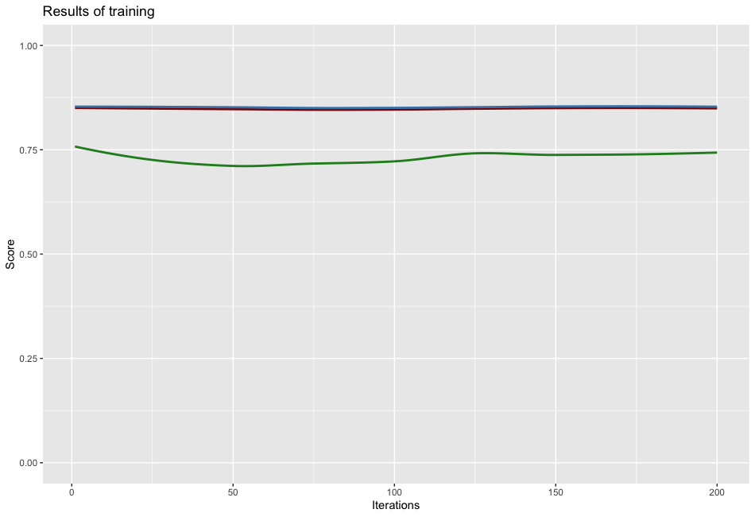
Attrition Prediction Model performance
Performed 200 test/train splits to test performance
Mean accuracy = 0.884
Mean sensitivity = 0.8525
Mean specificity = 0.7288

Slide 14
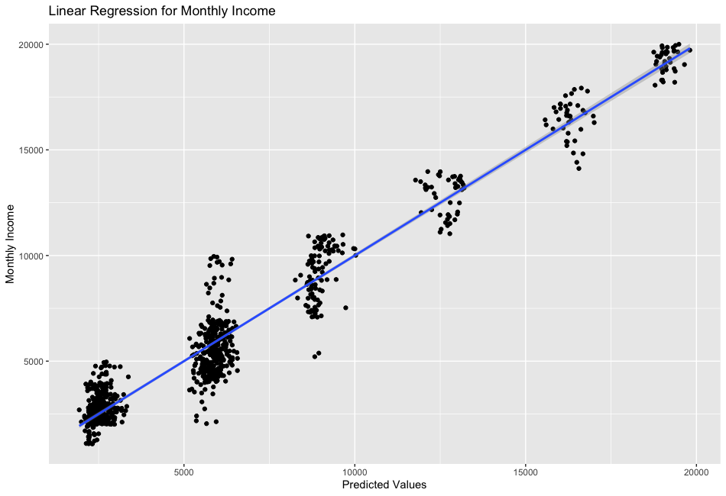
Monthly Income Prediction Model
Linear Regression Variables
JobLevel
JobRole
TotalWorkingYears
DistanceFromHome
Age
PerformanceRating
YearsAtCompany
YearsSinceLastPromotion
OverTime
Adjusted R² = 0.947
Predicted Residual Sum of Squares = 1051.06

Slide 15
Summary
Sales Representatives were the most likely to leave
A higher monthly income led to less attrition
Employees who worked overtime were more likely to leave
Further analysis could include the amount of over time worked

Slide 16
Contact Info
Tadd Backus
tbackus@mail.smu.edu

